Slide 1
Online College Voting System

Slide 2
ABSTRACT
An online voting system for college elections is a digital platform that allows students to cast their votes electronically through the internet. This system typically involves the use of a secure website or application where eligible voters, identified by their unique roll numbers, can log in and participate in the election process. Students can choose their preferred candidates or options within the platform, and the system records and counts the votes electronically.
This online voting system for college elections leverages student’s roll numbers as unique identifiers, ensuring a secure and efficient voting process. By associating each roll number with a single vote, the system maintains accuracy and prevents duplicate voting. Additionally, robust security measures are implemented to safeguard against unauthorized access and maintain the confidentiality of votes. This system aims to enhance transparency, accessibility, and overall efficiency in college elections through the integration of roll number-based voting

Slide 3
INTRODUCTION
In the digital age, where technology permeates every aspect of our lives, traditional methods of voting are evolving to meet the demands of efficiency, accessibility, and security. As we navigate through an era of unprecedented technological advancement, it's only fitting that our electoral processes follow suit. Hence, we introduce the concept of an Online Voting System tailored specifically for college elections.
An online voting system for college elections is a digital platform that allows students to cast their votes electronically through the internet. This system typically involves the use of a secure website or application where eligible voters, identified by their unique roll numbers, can log in and participate in the election process. Students can choose their preferred candidates or options within the platform, and the system records and counts the votes electronically.

Slide 4
EXISTING SYSTEM
Paper-based voting
The voter gets a blank ballot and use a pen or a marker to indicate he want to vote for which candidate . Hand-counted ballots is a time and labor consuming process, but it is easy to manufacture paper ballots and the ballots can be retained for verifying , this type is still the most common way to vote.
This system is very much time consuming and slow . It was the major type of electoral fraud found . Once the voting schedule is over, the result of the election cannot be declared immediately. All the ballot boxes are collected at a specific location and then the counting of the votes is carried out which is very much time.

Slide 5
KEY FEATURES OF OUR SYSTEM
Accessibility
Vote Anywhere: Accessible on any device with an internet connection.
24/7 Availability: Cast your vote at your convenience.
Efficiency
Automated Processes: Streamlined ballot creation, distribution, and tabulation.
Real-time Results: Instantaneous outcome announcements.
Engagement
Informative Profiles: Get to know the candidates through multimedia profiles.
Interactive Platform: Engage in discussions, forums, and Q&A sessions.
Security
Encryption: Protecting the integrity and confidentiality of votes.
Multi-factor Authentication: Ensuring secure access to the voting platform.
Audit Trails: Monitoring and tracking every action within the system.

Slide 6
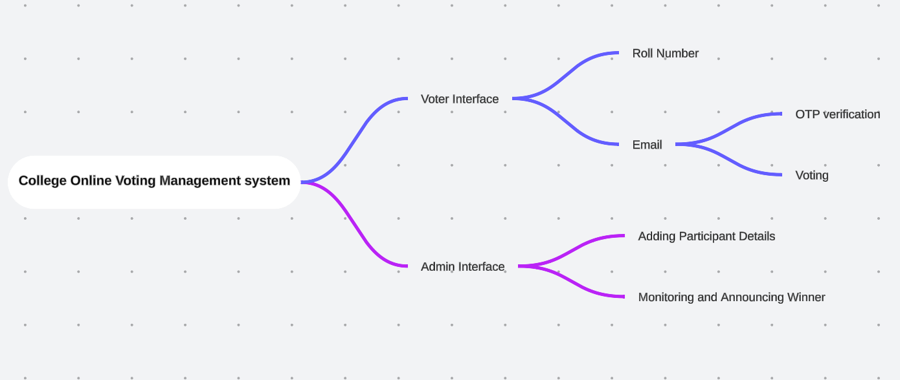
MIND MAPPING

Slide 7


INTERFACE

Slide 8
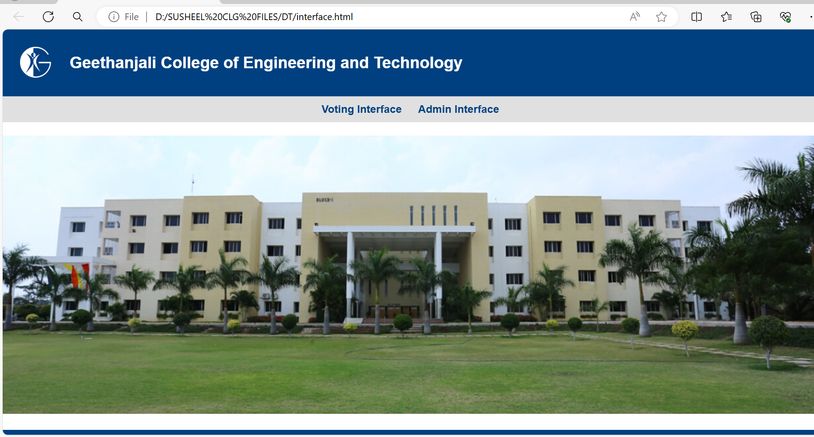
INTERFACE

Slide 9
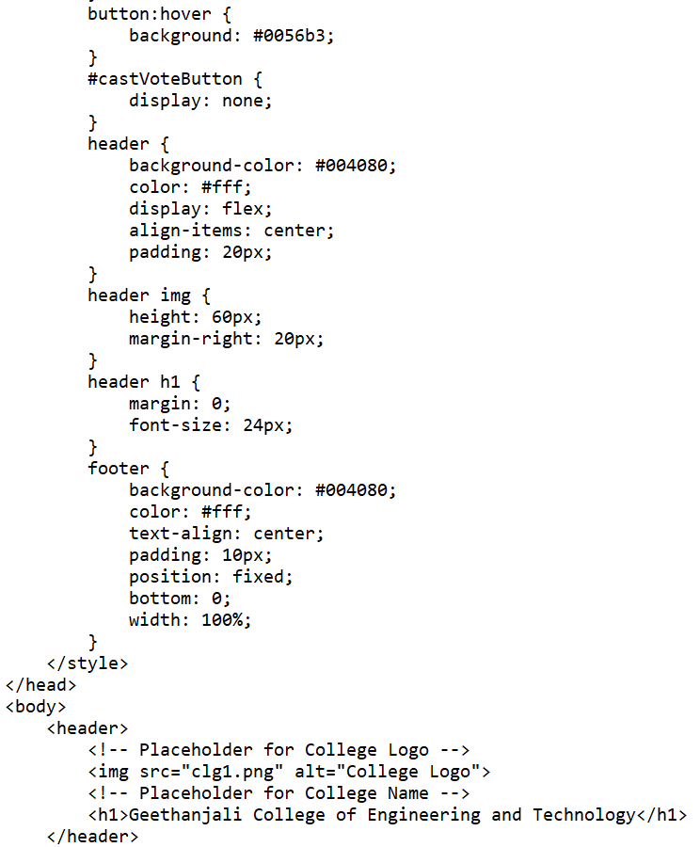
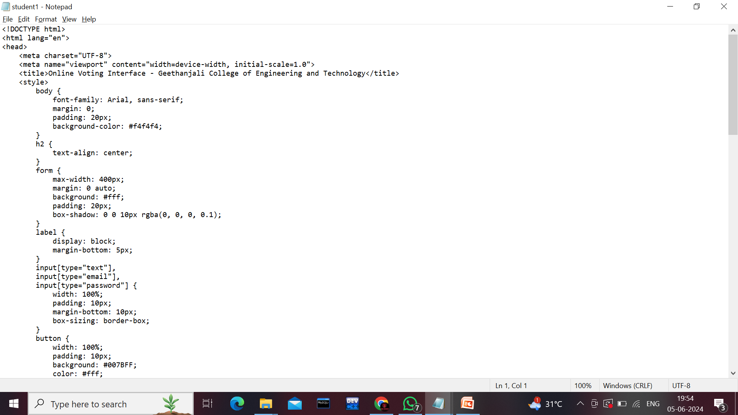
STUDENT LOGIN

Slide 10
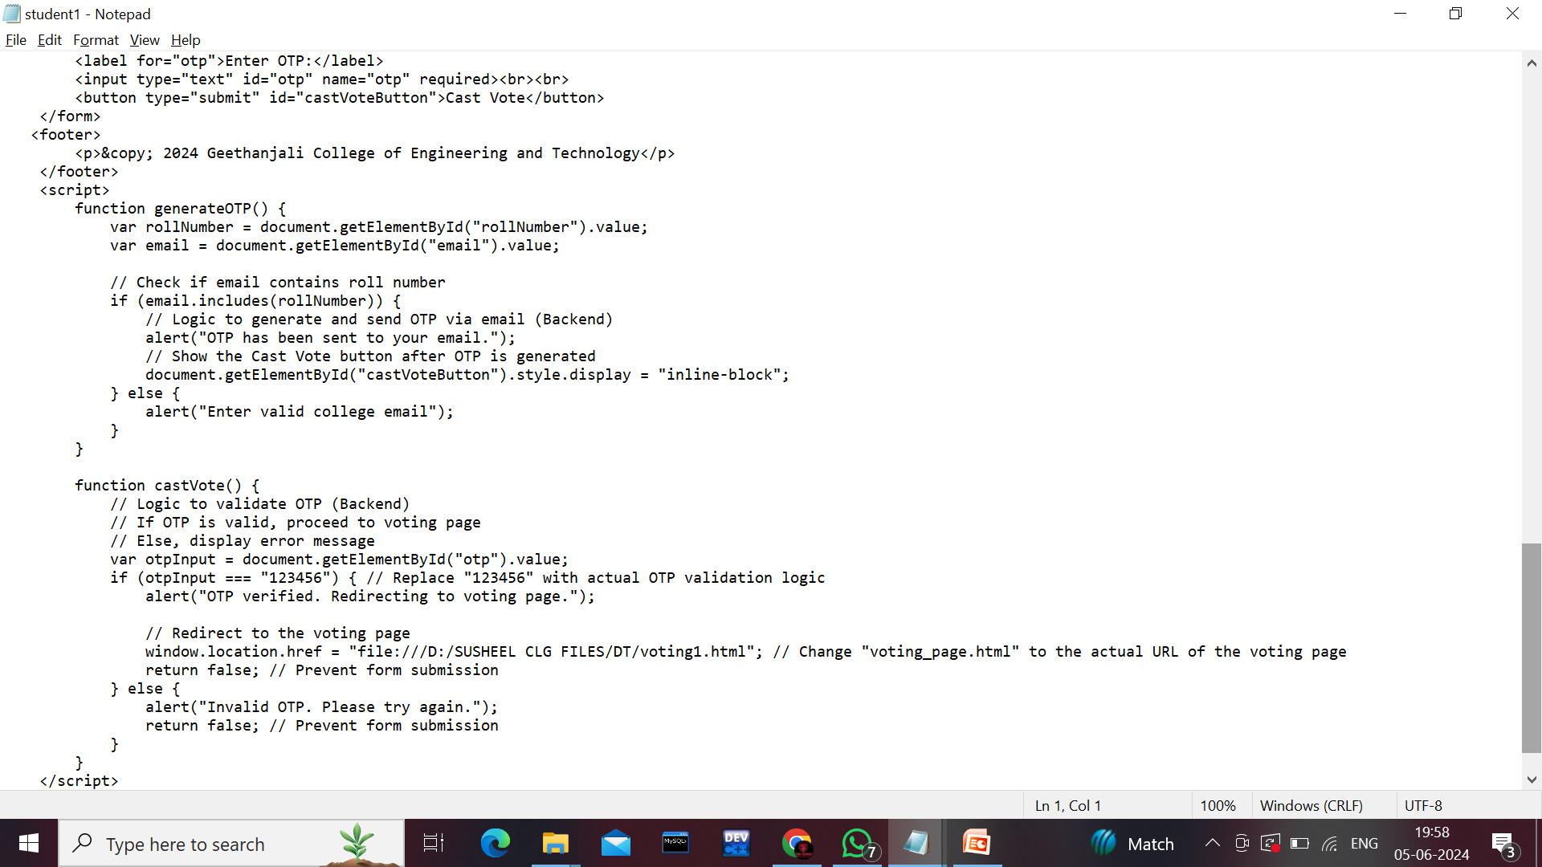
STUDENT LOGIN

Slide 11
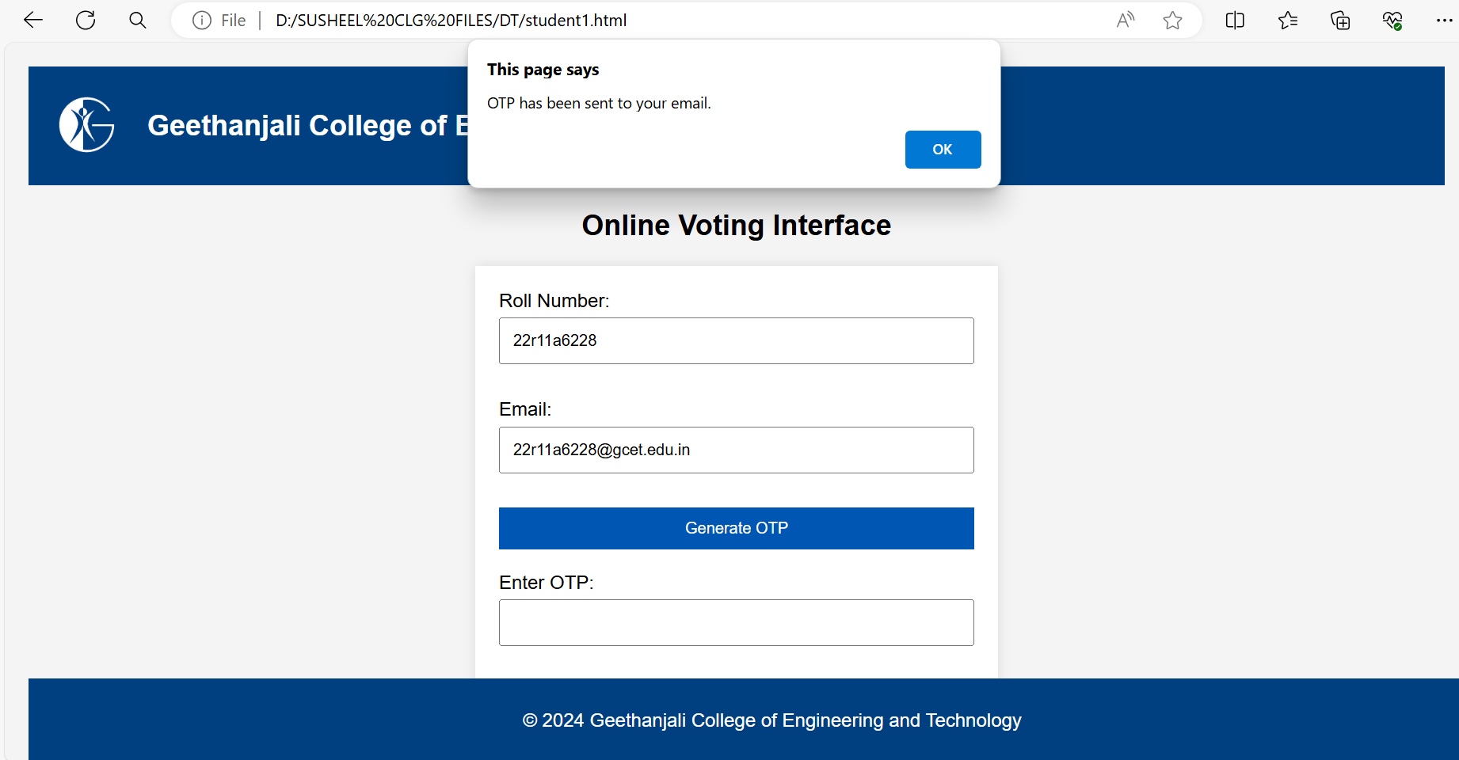
STUDENT LOGIN

Slide 12
VOTING PAGE

Slide 13
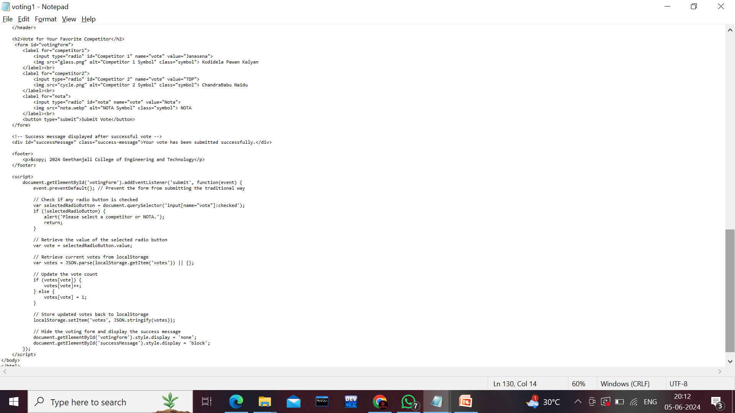
VOTING PAGE

Slide 14
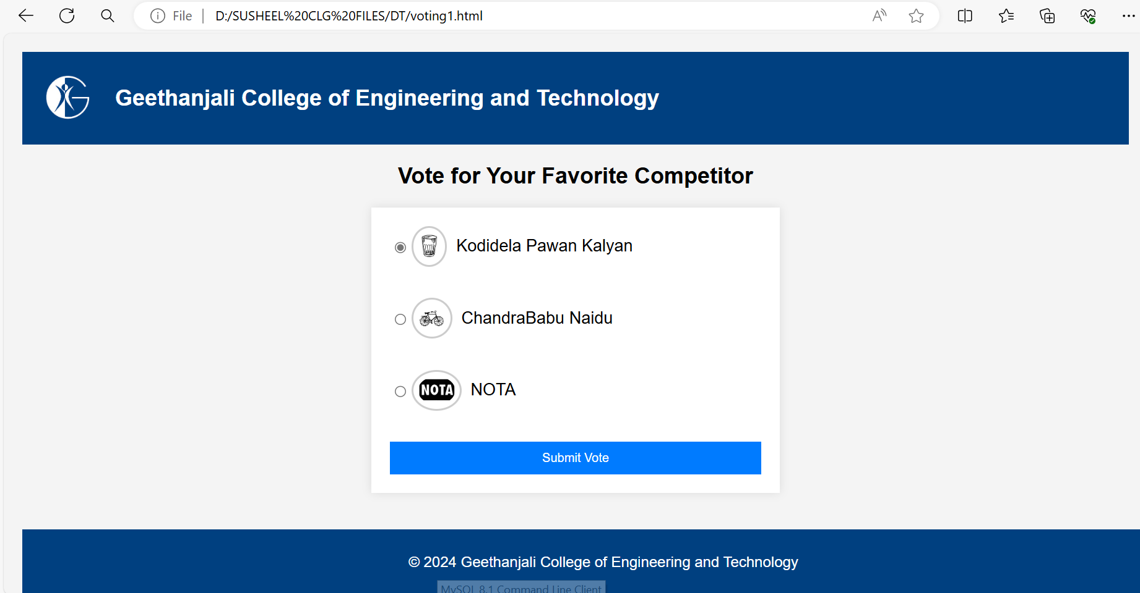
VOTING PAGE

Slide 15
ADMIN PAGE

Slide 16
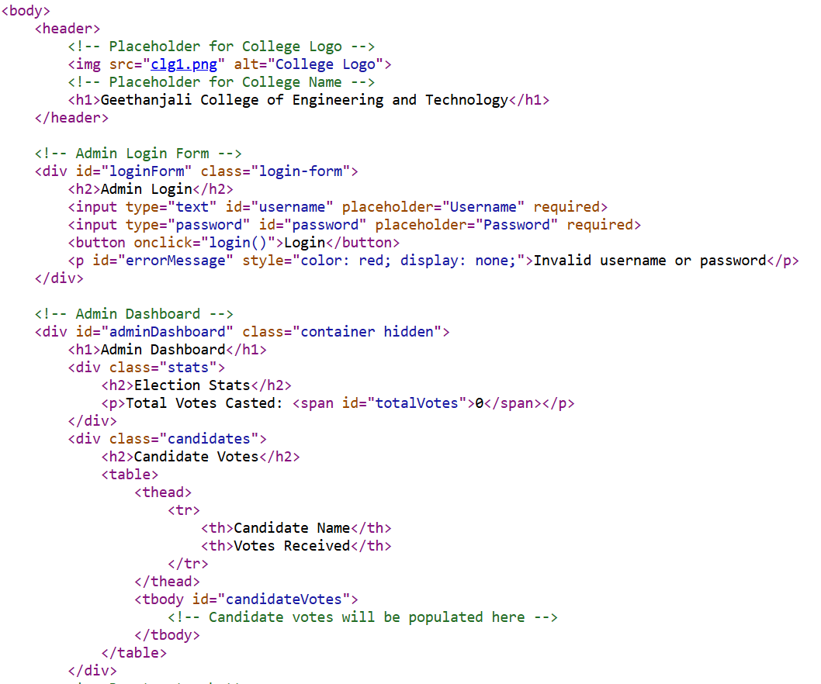
ADMIN PAGE

Slide 17
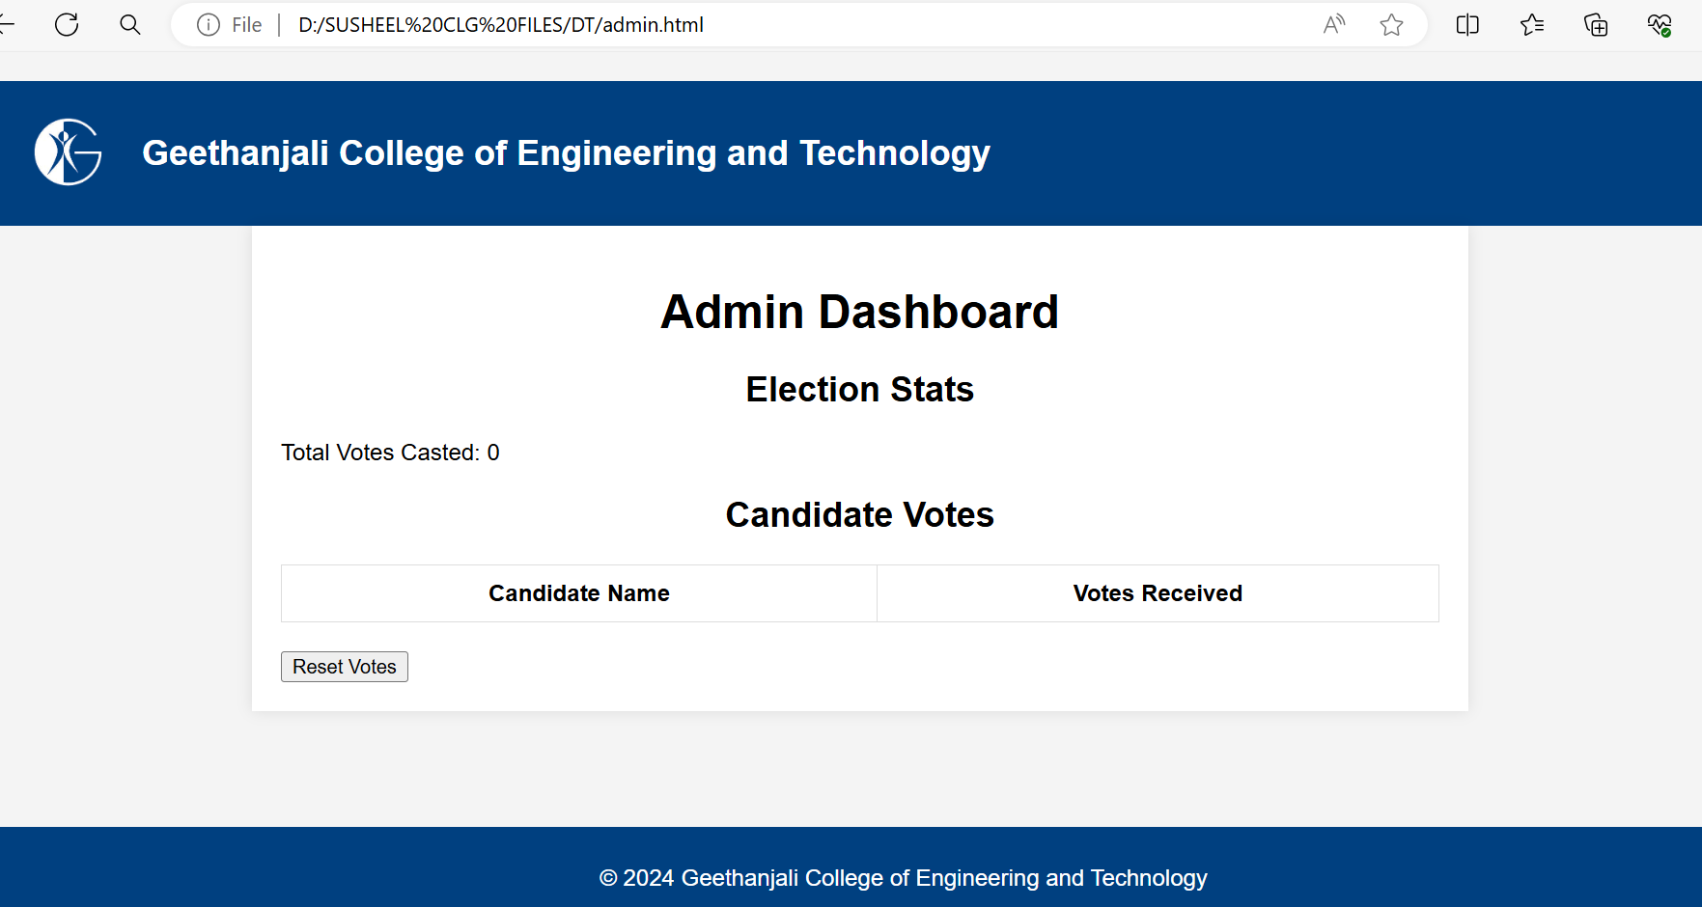
ADMIN PAGE

Slide 18
Thank You………

